Slide 1
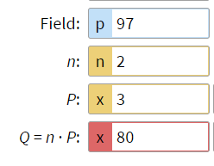
α:
A = α^{n}

Slide 2
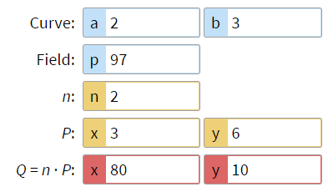
Determines what operation we use instead of multiplication
Modulus, same as before
Number of times to do the operation, same as before
Start point, was α, now is a point with two numbers
Answer, was A, now is a point with two numbers

Slide 3
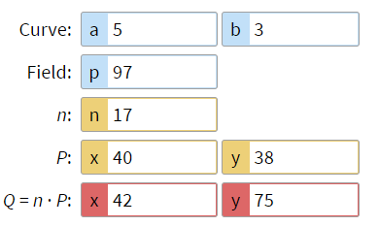
You and partner pick x and y for P
It becomes public information

Slide 4
Alice
Alice’s private key
Bob’s public key
Shared key; Alice and Bob should get the same answer

Slide 5
Bob
Bob’s private key
Alice’s public key
Shared key; Alice and Bob should get the same answer

Slide 6
Pick your private key
P is public info from the previous step
This is your public key

